Slide 1

LY TU TRONG TECHNICAL COLLEGE
HO CHI MINH CITY
390 HOANG VAN THU, WARD 4, TAN BINH DISTRICT, HCMC
TEL: (848)-8440567; (848)-4490589
www.lttc.edu.vn

Slide 2
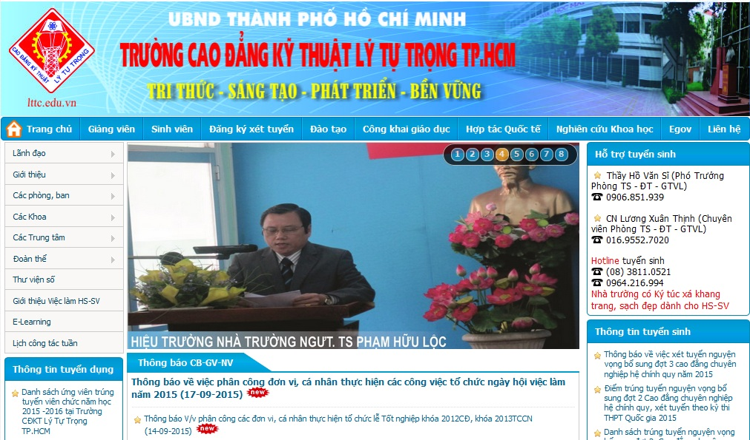
OFFICIAL WEBSITE OF LY TU TRONG TECHNICAL COLLEGE
HO CHI MINH CITY

Slide 3
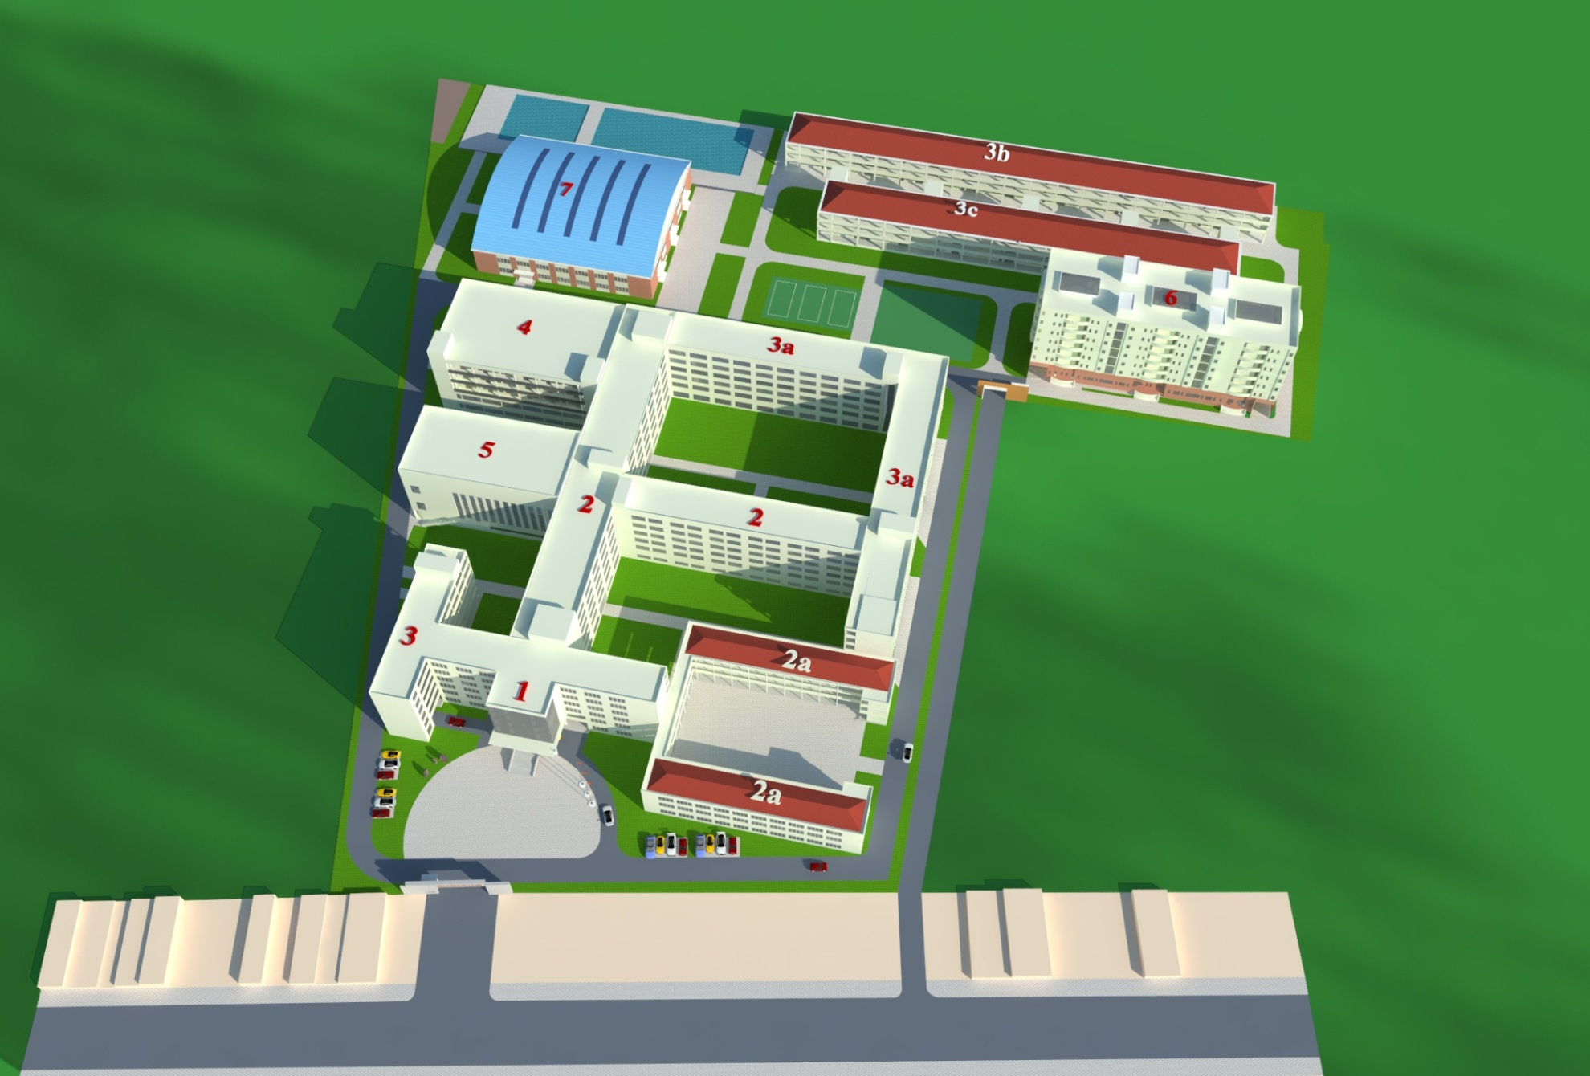
FUTURE OVERALL PLANNING OF LY TU TRONG TECHNICAL COLLEGE HO CHI MINH CITY

Slide 4
CONTENT
1
HISTORY AND DEVELOPMENT
2
ACADEMIC PROGRAMS
3
ORGANIZATION
4
STAFF & TEACHERS
5
FIELDS OF TRAINING
6
QUI MÔ ĐÀO TẠO

Slide 5
History and development
1
02-2005
Ly Tu Trong Tehnical College Ho Chi Minh City
03-1999
03-1995
Ly Tu Trong Technical High School
02-1986
Ly Tu Trong Vocational Training High School
Ly Tu Trong Vocational Training School

Slide 6

ACADEMIC PROGRAMS
COLLEGE DEGREE
HIGH SCHOOL
TECHNICIAN DEGREE
LY TU TRONG TECHNICAL COLLEGE HO CHI MINH CITY
SHORT-TERM TRAINING
COLLEGE DEGREE (TRANSFER)

Slide 7
ORGANIZATION
BOARD OF COMMUNIST PARTY LEADERS
LABOUR UNION
ACADEMIC – SCIENTIFIC COMMITEE
BOARD OF
ADMINISTRATORS
YOUTH AND STUDENT UNIONS
COLLEGE COMMITEE

Slide 8
8 DEPARTMENTS
DEPARTMENTS
ORGANIZATION AND ADMINISTRATION
ACADEMIC AFFAIRS
EDUCATION INSPECTION – STUDENT AFFAIRS
FINANCIAL PLANNING
TESTING - QUALITY ASSURANCE
FACILITY SUPPLY
SCIENTIFIC MANAGEMENT – INTERNATIONAL CORPORATION
FACILITY MANAGEMENT - SERVICE

Slide 9

FACULTIES
FOUNDATION SCIENCE
INFORMATION TECHNOLOGY
MECHANICAL ENGINEERING TECHNOLOGY
ELECTRICAL-ELECTRONICS ENGINEERING TECHNOLOGY
HEAT-REFRIGERATION ENGINEERING TECHNOLOGY
AUTOMOTIVE ENGINEERING TECHNOLOGY
GARMENT TECHNOLOGY-FASHION
POLITICAL THEORIES
ECONOMICS

Slide 10
HIGH SCHOOL - CENTERS
LY TU TRONG HIGH SCHOOL
INFORMATION CENTER - LIBRARY
LY TU TRONG TRAINING CENTER
GERMAN CENTER
TECHNOLOGY RESEARCH & TRANSFER CENTER
REGULAR EDUCATION CENTER
HEALTH CARE CENTER

